Slide 1

50.039 Theory and Practice of Deep Learning W10-S2 Generative Models in Deep Learning
Matthieu De Mari

Slide 2
About this week (Week 10)
What are typical generative models in deep learning?
What is an autoencoder and what are its uses?
What is a fractionally strided convolution layer?
What are variational autoencoders and why do noise representations of latent features work better than the ones in standard autoencoders?
What are Generative Adversarial Networks (GANs) and their uses?
What are the advanced techniques in GANs and deepfakes?

Slide 3
About this week (Week 10)
What are typical generative models in deep learning?
What is an autoencoder and what are its uses?
What is a fractionally strided convolution layer?
What are variational autoencoders and why do noise representations of latent features work better than the ones in standard autoencoders?
What are Generative Adversarial Networks (GANs) and their uses?
What are the advanced techniques in GANs and deepfakes?

Slide 4
Outline
In this lecture
Main issues of traditional Autoencoders
Diversity on feature representation using stochastic latent representations
Variational Autoencoder and stochastic latent representations
Basic Generative Adversarial Networks: ideas and procedure.
In the next lectures
More advanced concepts on GANs

Slide 5
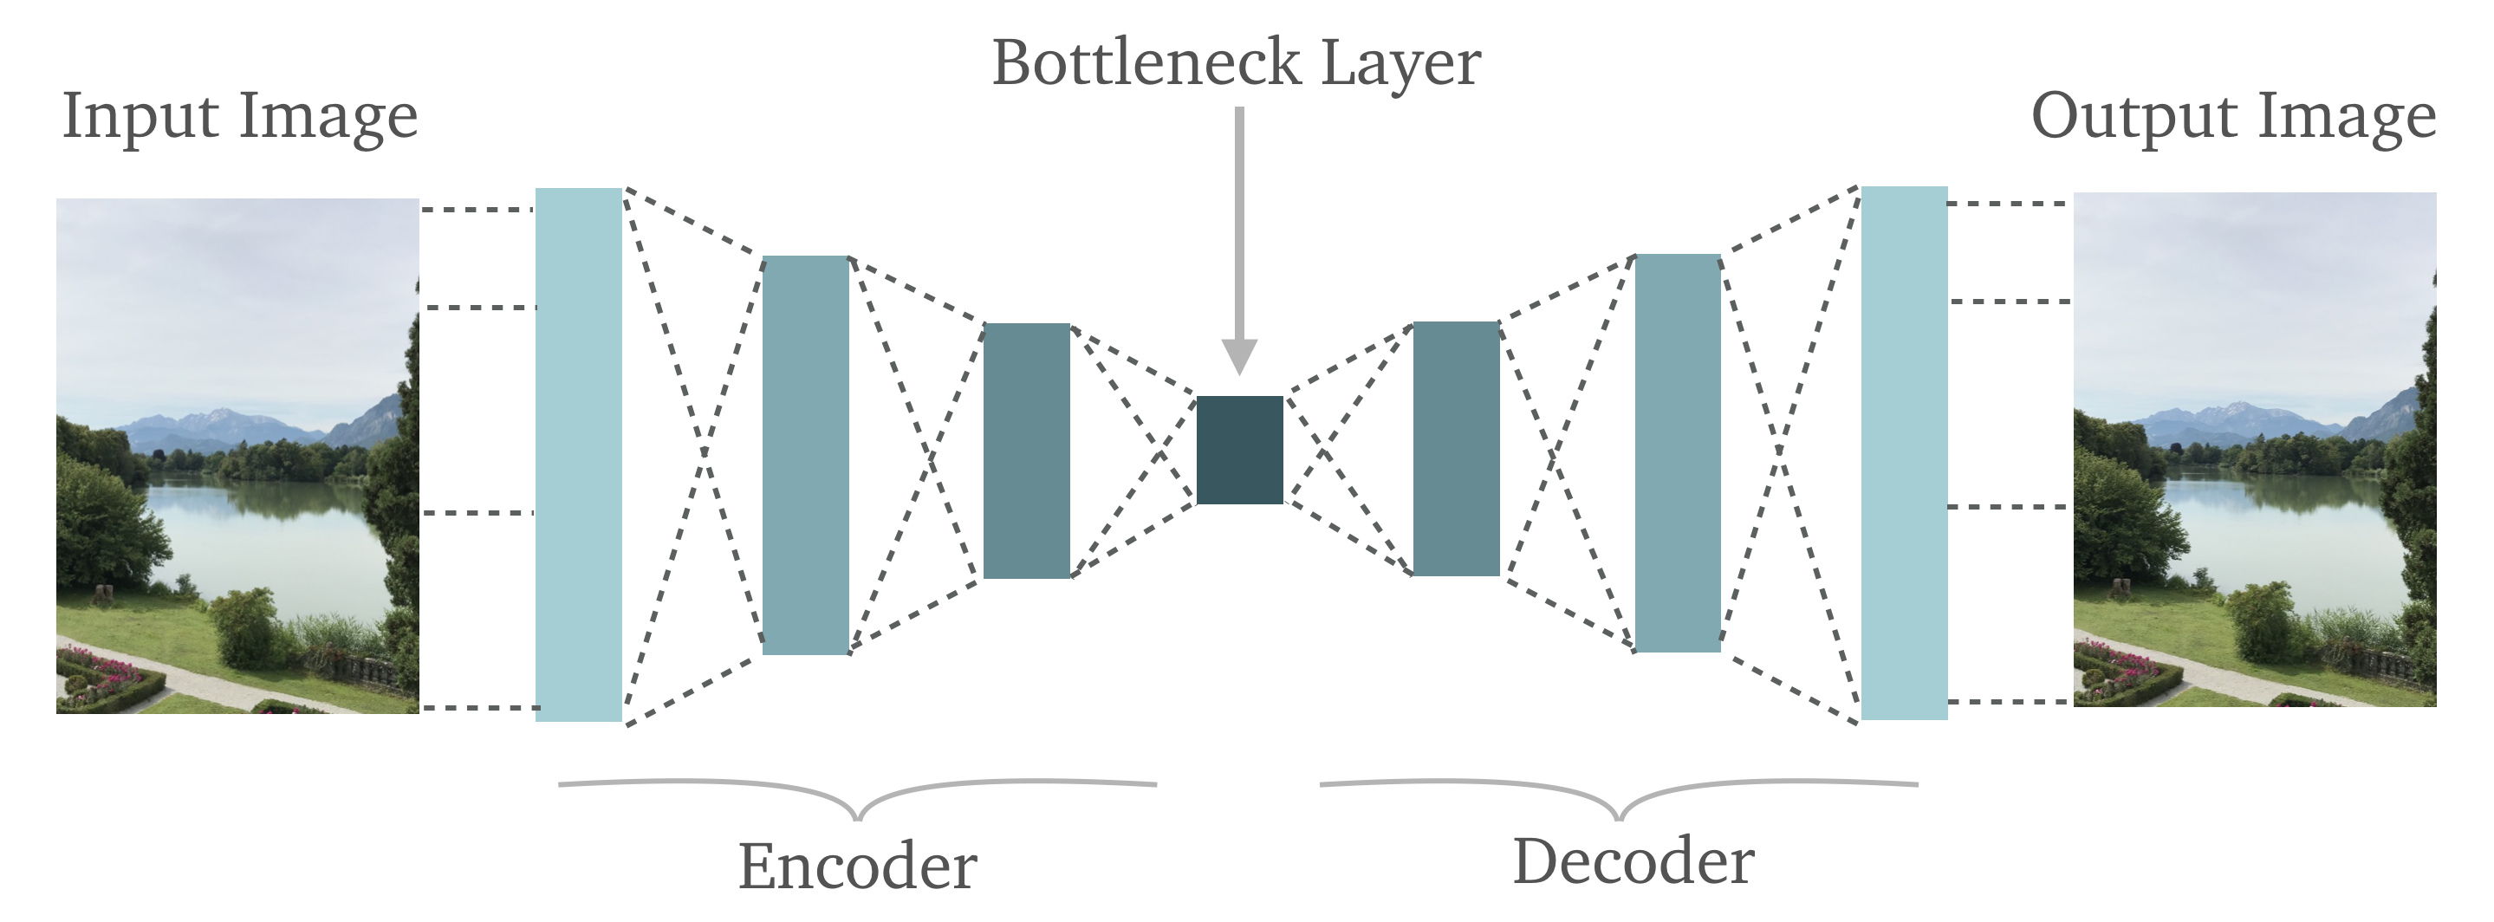
AutoEncoders: a definition
Definition (AutoEncoder):
An AutoEncoder is a neural network that learns to copy its input to its output. Basically, it attempts to approximate the identity function.
It has an internal (hidden) layer that describes a code used to represent the input, and is called the feature representation or latent representation of the input.

Slide 6
AutoEncoders: a definition

Slide 7
AutoEncoders: a definition
Definition (AutoEncoder):
An AutoEncoder is a neural network that learns to copy its input to its output.
It is constituted of two main parts:
an encoder that maps the input into the code,
and a decoder that maps the code to a reconstruction of the input.

Slide 8
AutoEncoders: a definition
Definition (AutoEncoder):
Autoencoders are usually restricted in their latent representation dimensionality.
This forces them to reconstruct the input approximately, preserving only the most relevant aspects of the data in the copy.

Slide 9
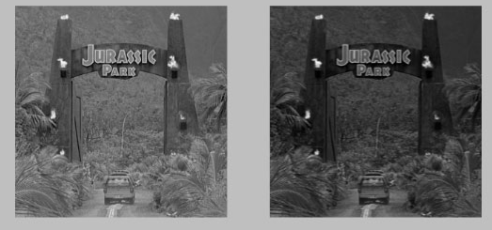
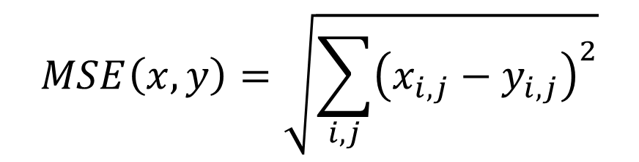
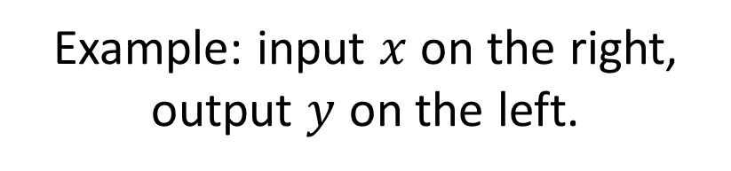
AutoEncoders structure
Reconstruction Loss: This is the method that measures measure how well the decoder is performing and how close the output is to the original input. In the case of images, we can typically use an MSE on all pixels, or variations of it.
Example: input $x$ on the right, output $y$ on the left.
$$MSE\left(x,y\right)=\sqrt{\sum_{i,j}{{\left(x_{i,j}−y_{i,j}\right)}^{2}}}$$

Slide 10
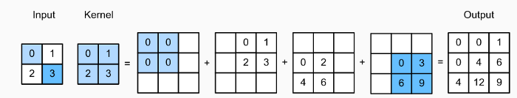
Deconvolution operation
Definition (Deconvolution layer):
The Deconvolution (also commonly referred to as Transposed Convolution, or Fractionally Strided Convolution) layer is used to upsample the input feature map to a desired output feature map using some learnable parameters.
Works as a convolution, multiply input with kernel elements but copy output in multiple locations to upsample.

Slide 11
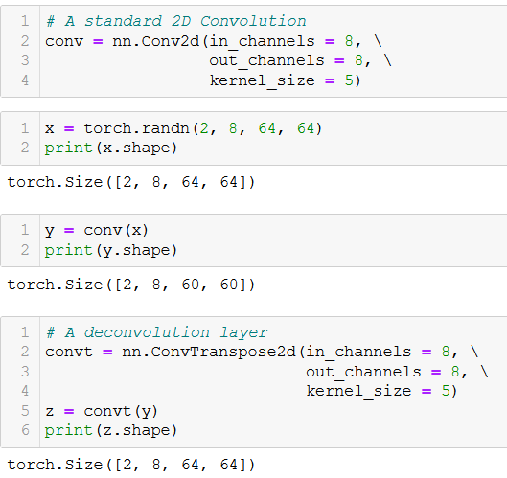
Deconvolution operation
Deconvolution layers are trainable layers, which allow to upsample an input (as opposed to downsampling Convolution layers).
They are easily implemented on PyTorch, using the ConvTranspose types of layers (exists in 1D, 2D, and n-D if needed).

Slide 12
Limits of “vanilla” autoencoders
Encoders in “Vanilla” autoencoders take an input and output a fixed single value for each encoding dimension of the latent representation.
The decoder network then subsequently takes these values and attempts to recreate the original input.
A variational autoencoder (VAE) provides a probabilistic manner for describing an observation in latent space.
Thus, rather than building an encoder which outputs a single value to describe each latent state attribute, we will formulate our encoder to describe a probability distribution for each latent attribute.

Slide 13
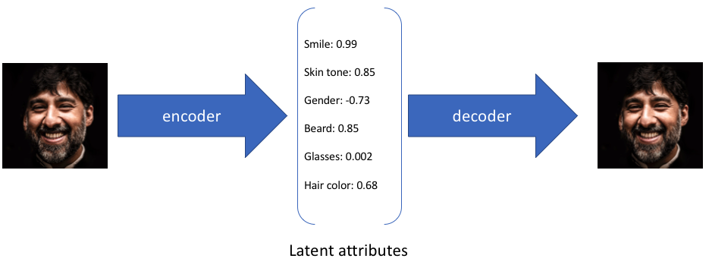
Limits of “vanilla” autoencoders

Slide 14
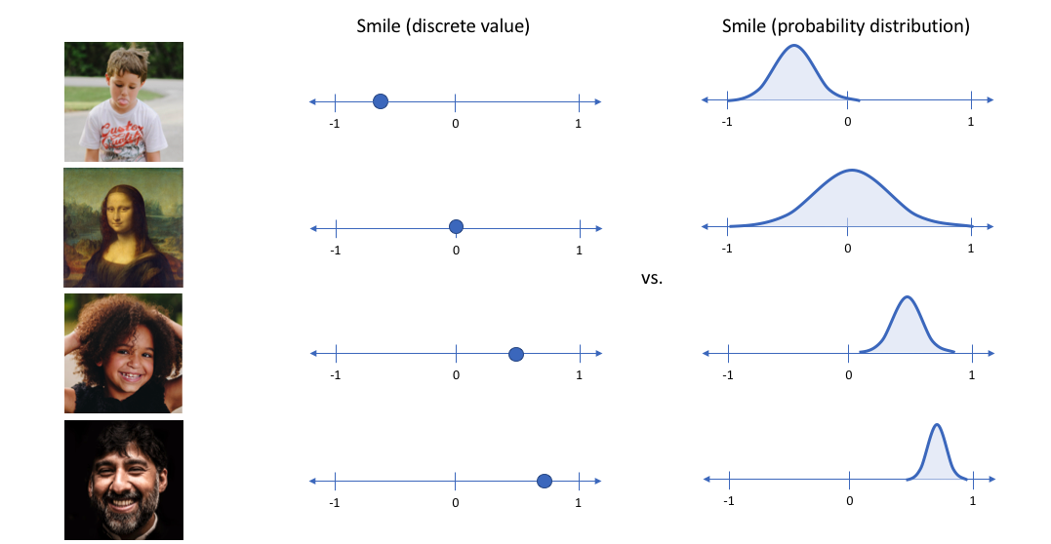
Limits of “vanilla” autoencoders

Slide 15
Limits of “vanilla” autoencoders

Slide 16
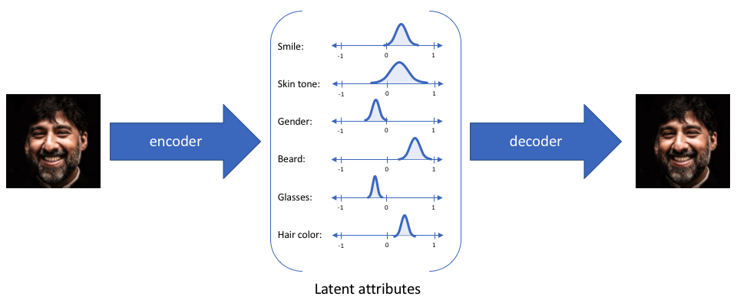
Limits of “vanilla” autoencoders

Slide 17
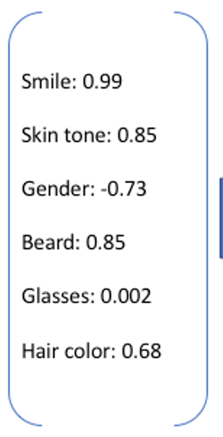
A twist on the “vanilla” autoencoder
Definition (Variational Autoencoder):
A variational autoencoder fulfils the same job as a standard autoencoder but the key difference is it attempts to learn
how to represent inputs into,
and how to reconstruct outputs from a probabilistic latent space/representation instead of a deterministic one.

Slide 18
A twist on the “vanilla” autoencoder
Just like before with vanilla autoencoders, a variational autoencoder consists of four parts.
Encoder
Probabilistic latent Representation in bottleneck layer
Decoder
Reconstruction loss

Slide 19
A twist on the “vanilla” autoencoder
Encoder (as before)
Decoder (as before)
Note: for VAEs, the encoder model is sometimes referred to as the recognition model,
Whereas the decoder model is sometimes referred to as the generative model.

Slide 20
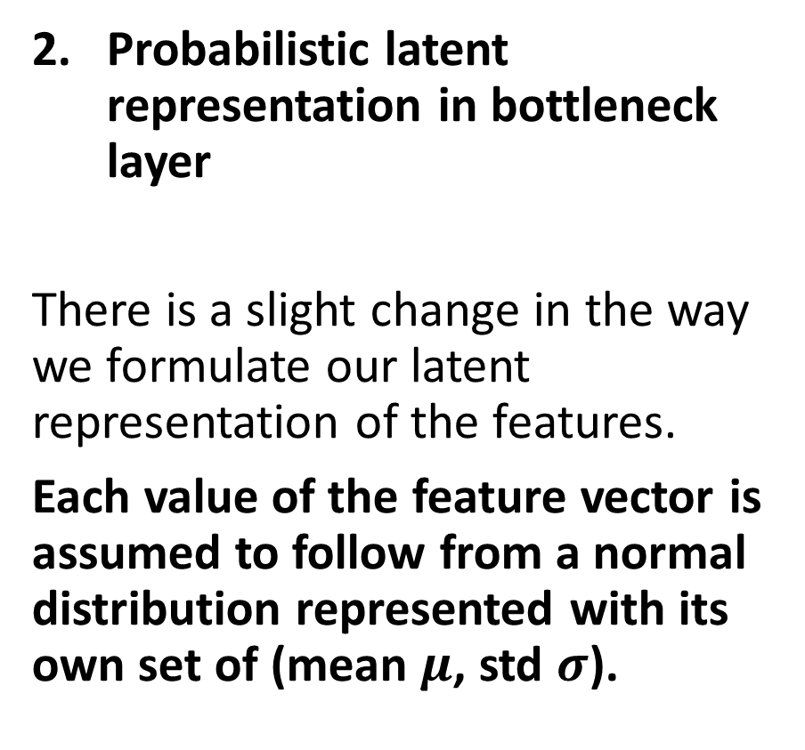
A twist on the “vanilla” autoencoder
Probabilistic latent representation in bottleneck layer
There is a slight change in the way we formulate our latent representation of the features.
Each value of the feature vector is assumed to follow from a normal distribution represented with its own set of (mean $μ$, std $σ$).

Slide 21
A twist on the “vanilla” autoencoder
Probabilistic latent representation in bottleneck layer
Right before the decoder phase, we then sample a latent vector from the distributions we have identified.
This vector is then used for reconstruction in the decoder.

Slide 22
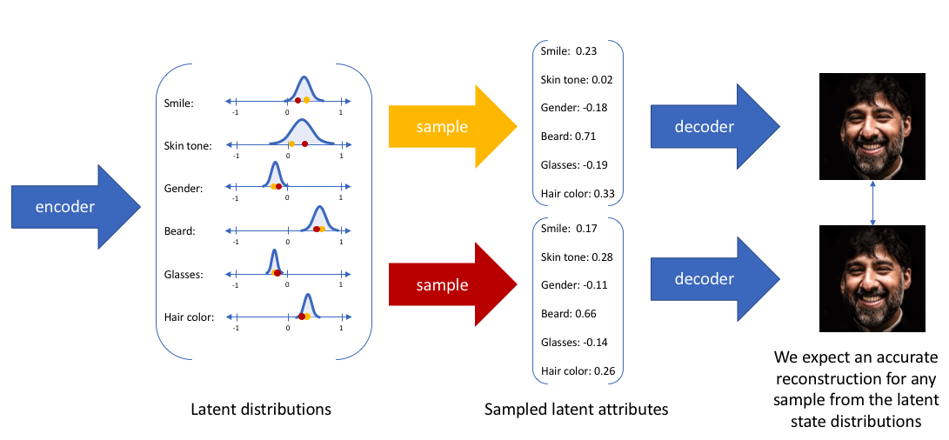
Important note: this means that two forward passes of the same image could have different latent vectors and reconstructed images.

Slide 23
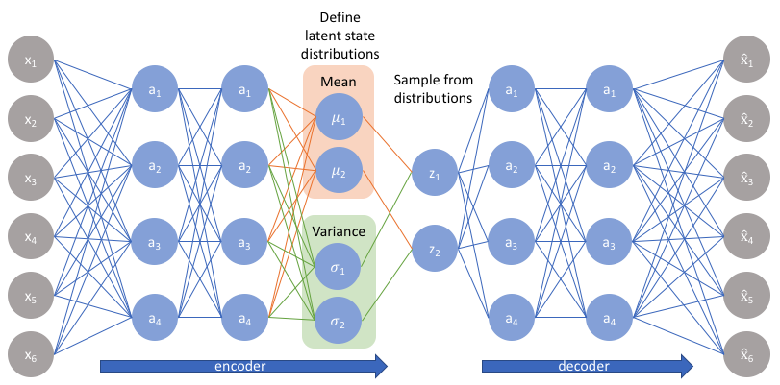
A twist on the “vanilla” autoencoder

Slide 24
A twist on the “vanilla” autoencoder
Just like before with vanilla autoencoders, a variational autoencoder consists of four parts.
Encoder (as before)
Probabilistic latent Representation in bottleneck layer
Decoder (as before)
Reconstruction loss

Slide 25
A twist on the “vanilla” autoencoder
Just like before with vanilla autoencoders, a variational autoencoder consists of four parts.
Encoder (as before)
Probabilistic latent representation in bottleneck layer
Decoder (as before)
Reconstruction loss

Slide 26
A twist on the “vanilla” autoencoder
Why is that better?
By constructing our encoder model to output a range of possible values (a statistical distribution) from which we will randomly sample to feed into our decoder model, we are essentially enforcing a continuous, smooth latent space representation.

Slide 27
A twist on the “vanilla” autoencoder
This will have two effects
The decoder will have to work harder to reconstruct images as the latent vector could be different for two forward passes (SkipGram vs. CBoW effect?)
The space for latent vectors will be used more uniformly (which could mean less compression on the encoder side?)

Slide 28
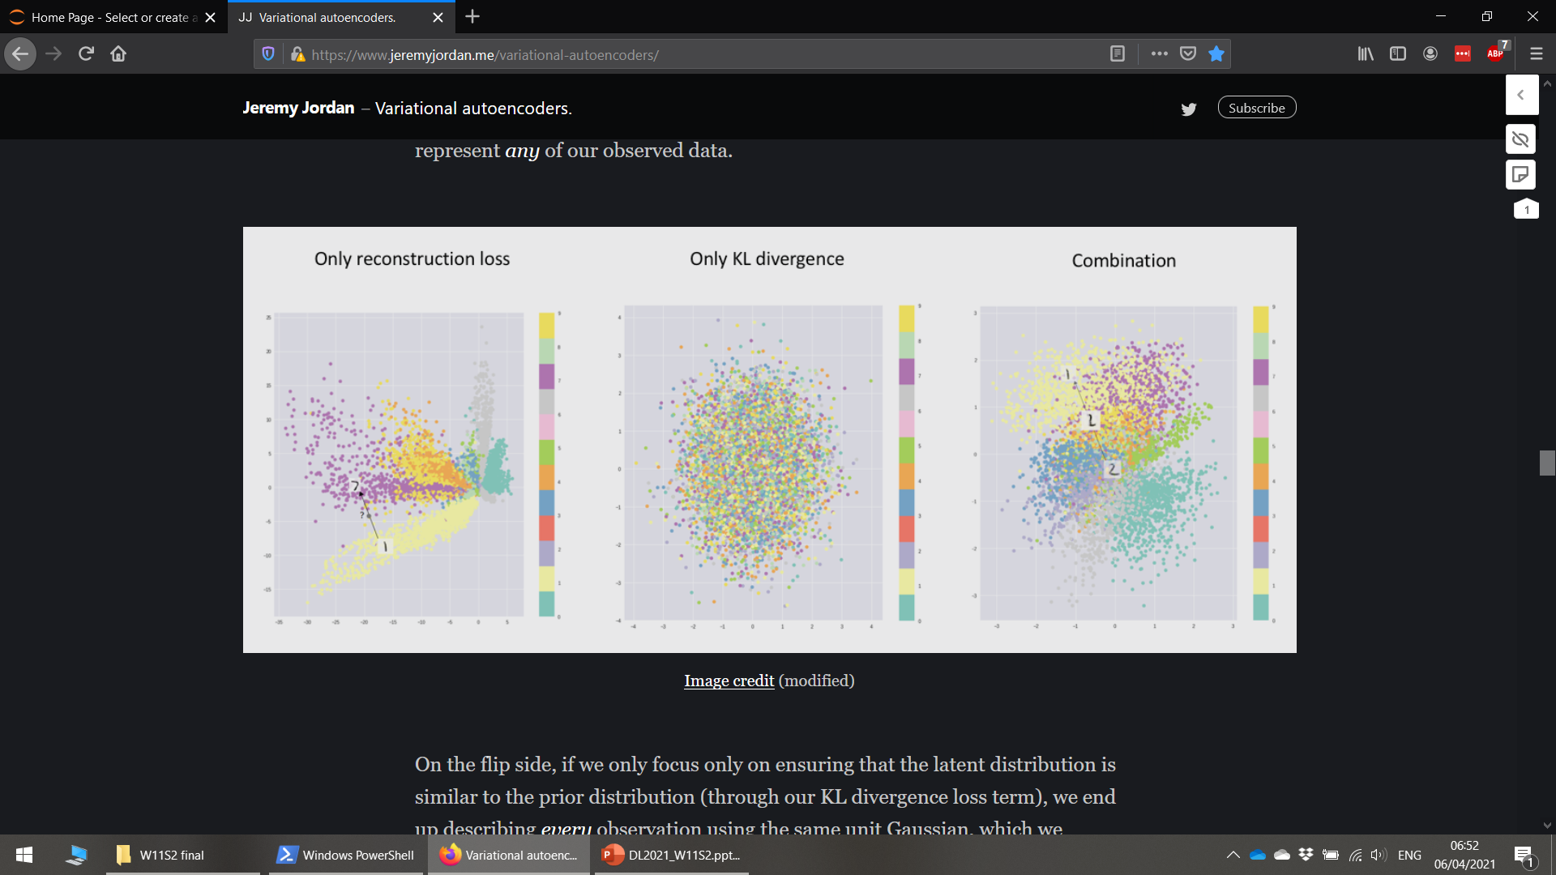
A twist on the “vanilla” autoencoder
Vanilla autoencoder
Variational autoencoder

Slide 29
A twist on the “vanilla” autoencoder
Another effect is that
For any sampling of the latent distributions, we are expecting our decoder model to be able to accurately reconstruct an image.
Thus, values which are nearby to one another in latent space should correspond with very similar reconstructions.

Slide 30
A twist on the “vanilla” autoencoder
Vanilla autoencoder
Variational autoencoder

Slide 31
A twist on the “vanilla” autoencoder
More importantly,
This also means that any random noise vector can be used used as an input for the decoder,
And this random encoding vector given to the decoder has high chances of producing an output which looks plausible!
In other words,
We could therefore get a decoder Neural Network, which could generate plausible images out of any noise vector,
Or in other words, a model that can generate plausible images out of thin air!

Slide 32
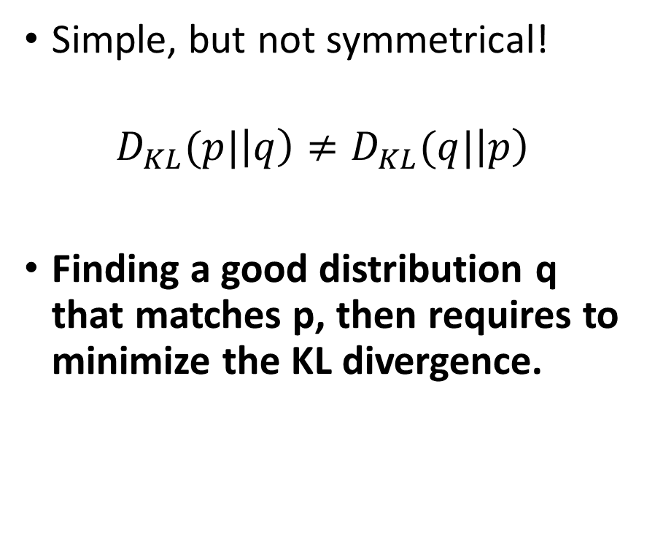
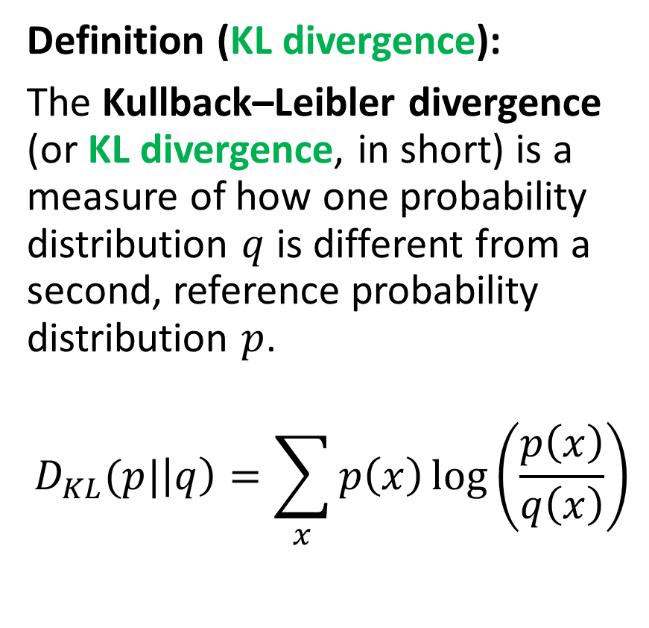
The Kullback–Leibler Divergence
Definition (KL divergence):
The Kullback–Leibler divergence (or KL divergence, in short) is a measure of how one probability distribution $q$ is different from a second, reference probability distribution $p$.
$$D_{KL}(p|\left|q\right)=\sum_{x}{p\left(x\right)\log\left(\frac{p\left(x\right)}{q\left(x\right)}\right)}$$
Simple, but not symmetrical!
$$D_{KL}(p|\left|q\right)≠D_{KL}(q|\left|p\right)$$
Finding a good distribution q that matches p, then requires to minimize the KL divergence.

Slide 33
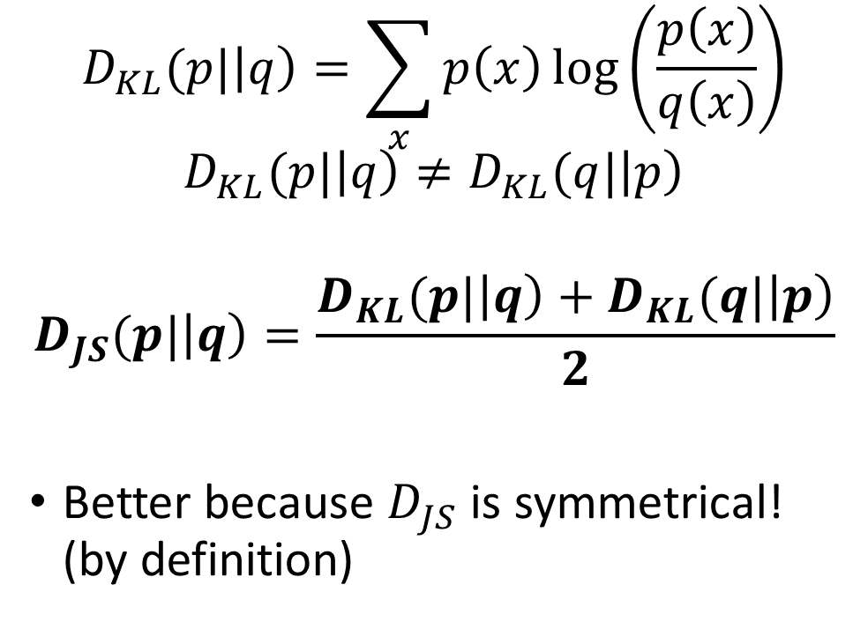
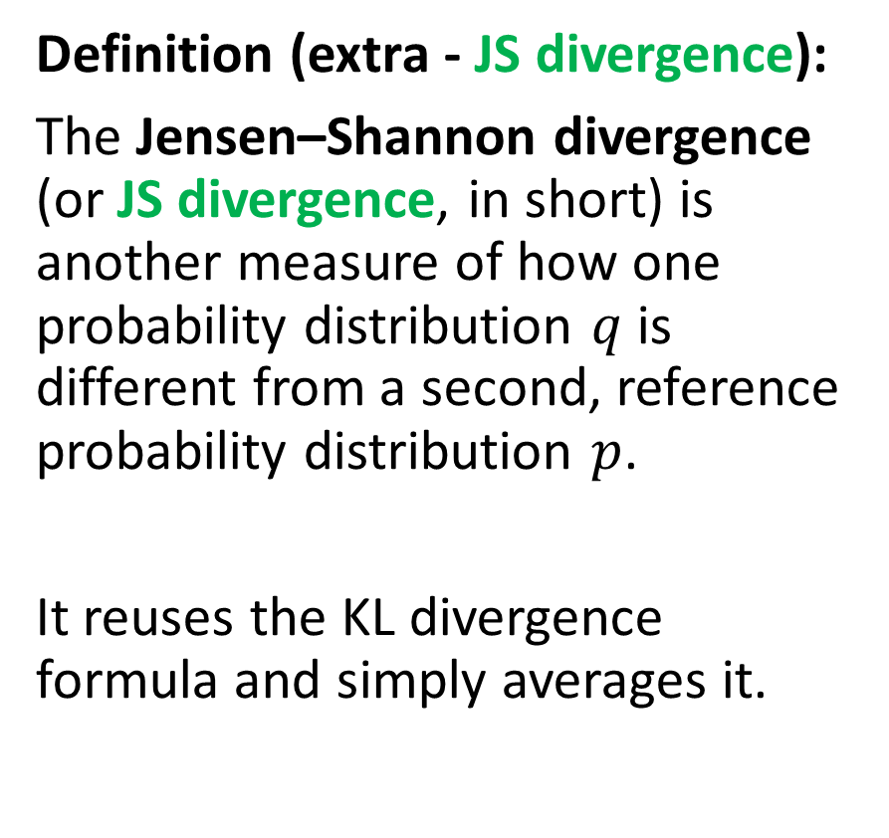
The Jensen-Shannon Divergence
Definition (extra - JS divergence):
The Jensen–Shannon divergence (or JS divergence, in short) is another measure of how one probability distribution $q$ is different from a second, reference probability distribution $p$.
It reuses the KL divergence formula and simply averages it.
$$D_{KL}(p|\left|q\right)=\sum_{x}{p\left(x\right)\log\left(\frac{p\left(x\right)}{q\left(x\right)}\right)}$$
$$D_{KL}(p|\left|q\right)≠D_{KL}(q|\left|p\right)$$
$$D_{JS}(p|\left|q\right)=\frac{D_{KL}(p|\left|q\right)+D_{KL}(q|\left|p\right)}{2}$$
Better because $D_{JS}$ is symmetrical! (by definition)

Slide 34
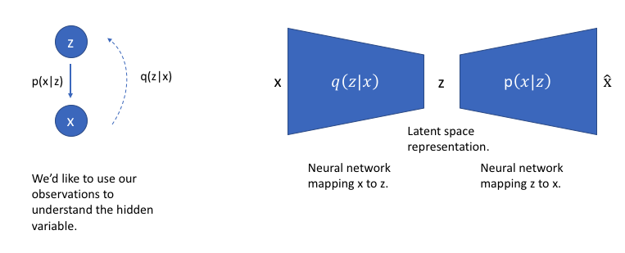
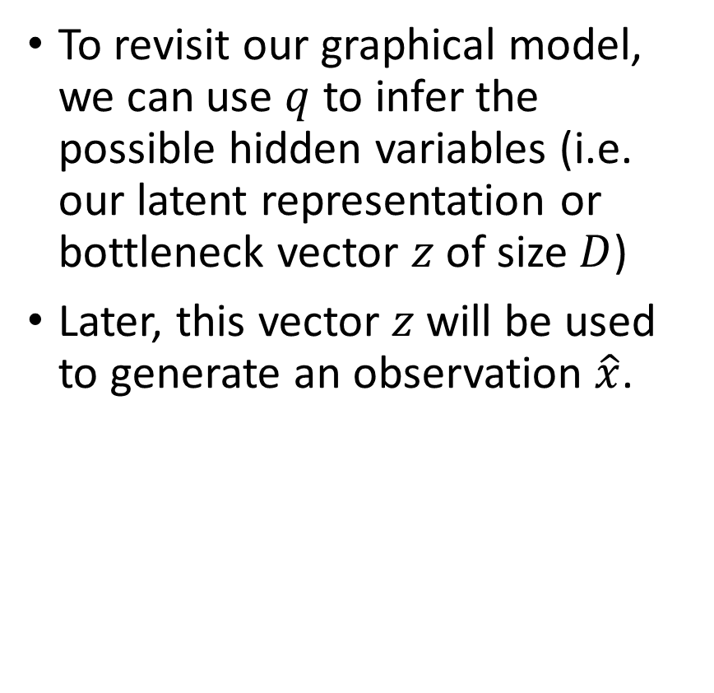
Back to our VAE
To revisit our graphical model, we can use $q$ to infer the possible hidden variables (i.e. our latent representation or bottleneck vector $z$ of size $D$)
Later, this vector $z$ will be used to generate an observation $\hat{x}$.

Slide 35
Back to our VAE

Slide 36
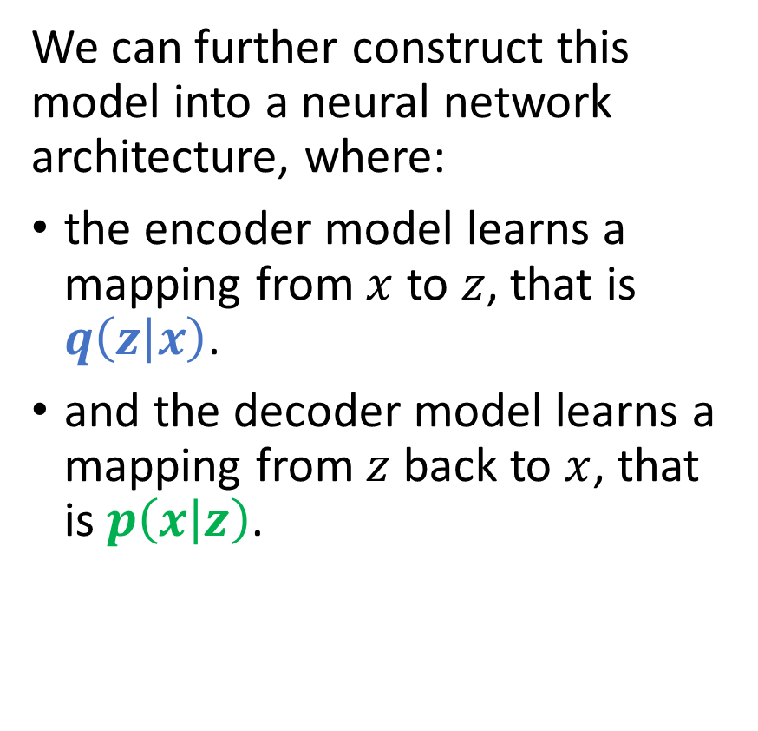
Back to our VAE
We can further construct this model into a neural network architecture, where:
the encoder model learns a mapping from $x$ to $z$, that is $q\left(z | x\right)$.
and the decoder model learns a mapping from $z$ back to $x$, that is $p\left(x | z\right)$.

Slide 37
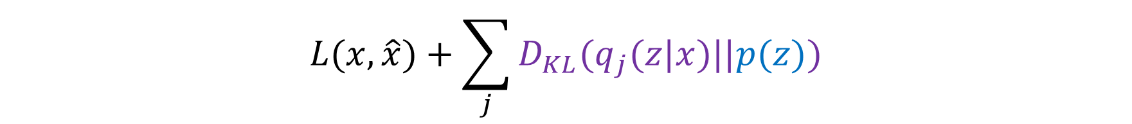

Back to our VAE
Reconstruction loss
Our loss function for this network will now consist of two terms:
one which penalizes reconstruction error (which can be thought of maximizing the reconstruction likelihood as discussed earlier)
and a second term which encourages our learned distribution $q(z|x)$ to be similar to a target distribution $p\left(z\right)$.
$$L(x,\hat{x})+\sum_{j}{D_{KL}(q_{j}(z|x)||p(z))}$$

Slide 38
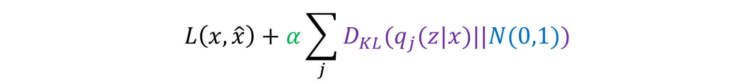
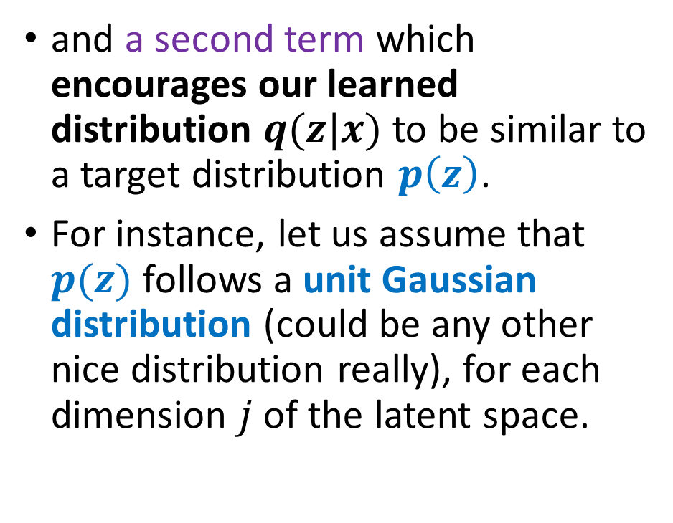
Back to our VAE
Reconstruction loss
Our loss function for this network will now consist of two terms:
one which penalizes reconstruction error (which can be thought of maximizing the reconstruction likelihood as discussed earlier)
and a second term which encourages our learned distribution $q(z|x)$ to be similar to a target distribution $p\left(z\right)$.
For instance, let us assume that $p(z)$ follows a unit Gaussian distribution (could be any other nice distribution really), for each dimension $j$ of the latent space.
$$L\left(x,\hat{x}\right)+α\sum_{j}{D_{KL}(q_{j}(z|x)||N(0,1))}$$

Slide 39
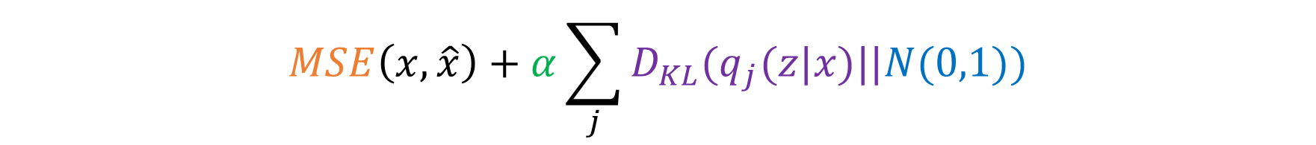
Back to our VAE
Reconstruction loss
Our loss function for this network will now consist of two terms:
one which penalizes reconstruction error (which can be thought of maximizing the reconstruction likelihood as discussed earlier)
and a second term which encourages our learned distribution $q(z|x)$ to be similar to a target distribution $p\left(z\right)$.
For instance, let us assume that $p(z)$ follows a unit Gaussian distribution (could be any other nice distribution really), for each dimension $j$ of the latent space.
$$MSE\left(x,\hat{x}\right)+α\sum_{j}{D_{KL}(q_{j}(z|x)||N(0,1))}$$

Slide 40
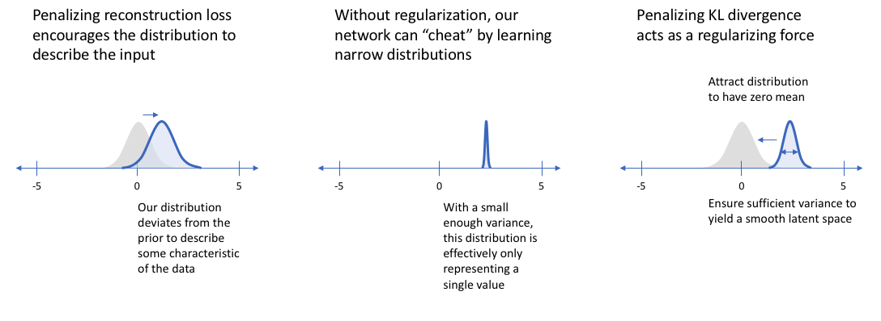
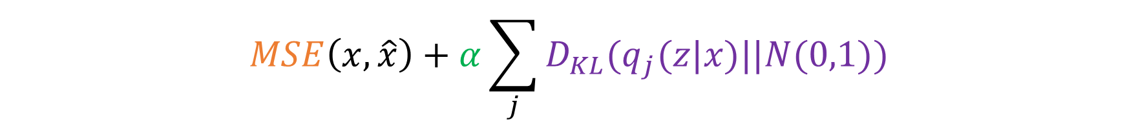
Back to our VAE
$$MSE\left(x,\hat{x}\right)+α\sum_{j}{D_{KL}(q_{j}(z|x)||N(0,1))}$$

Slide 41
Implementation of a VAE
The implementation of a VAE is out of the scope of this class.
The important notions we want to learn are
Using probabilistic latent representations, instead of fixed ones, distributes the embeddings or features vectors over the latent space in a more uniform way, occupying the entire space.

Slide 42
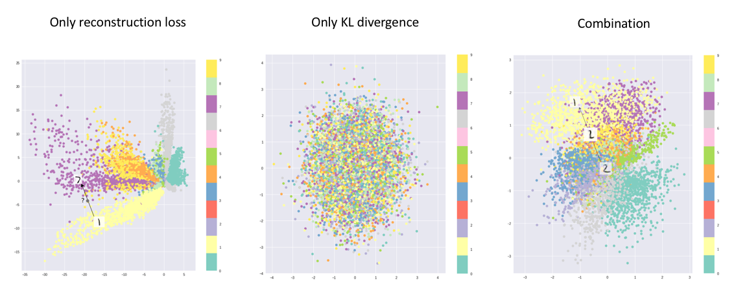
Effect of KL term on latent space

Slide 43
Implementation of a VAE
The training of a VAE is out of the scope of this class.
The important notions we want to learn are:
Using probabilistic latent representations, instead of fixed ones, distributes the embeddings or features vectors over the latent space in a more uniform way, occupying the entire space.
This is done by adding a simple KL term to our reconstruction loss, which acts as a regularization of some sort.
This also means that any randomly generated latent vector could technically produce a good-looking output via the decoder.

Slide 44
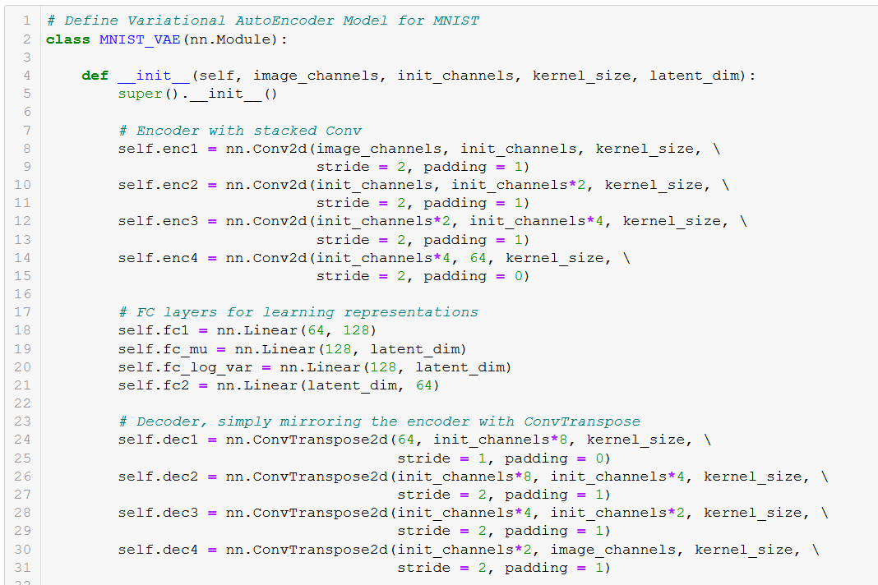

Slide 45
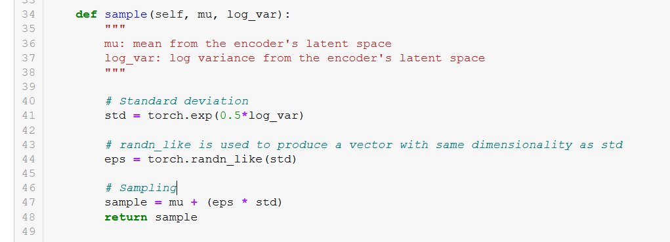

Slide 46
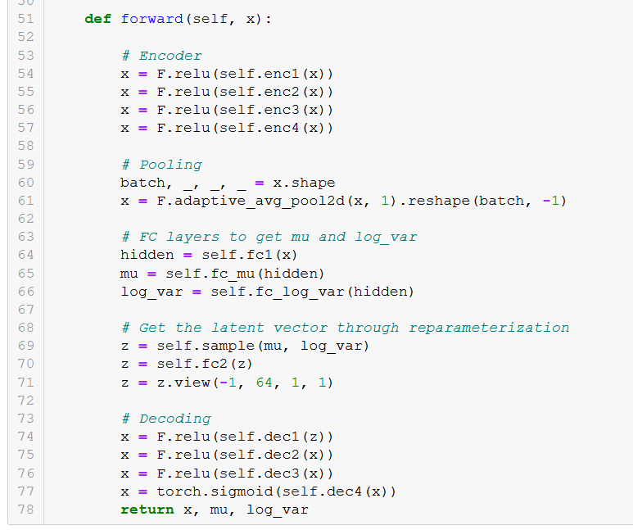

Slide 47
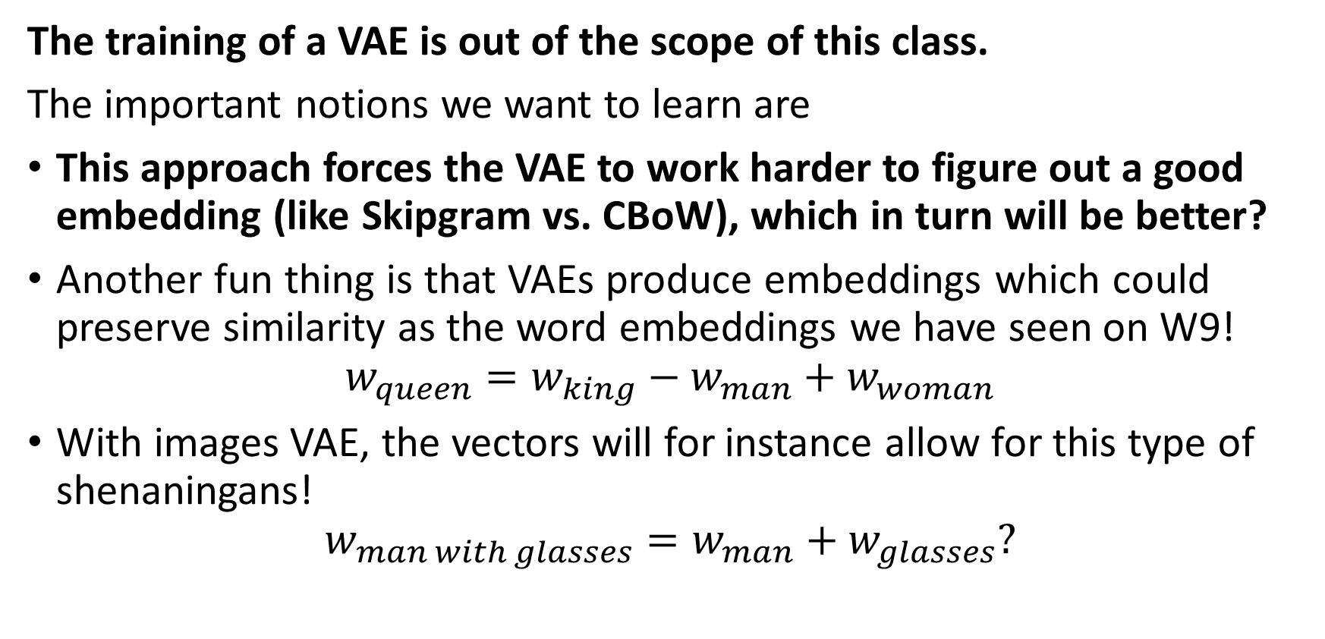
Implementation of a VAE
The training of a VAE is out of the scope of this class.
The important notions we want to learn are
This approach forces the VAE to work harder to figure out a good embedding (like Skipgram vs. CBoW), which in turn will be better?
Another fun thing is that VAEs produce embeddings which could preserve similarity as the word embeddings we have seen on W9!
$$w_{queen}=w_{king}−w_{man}+w_{woman}$$
With images VAE, the vectors will for instance allow for this type of shenaningans!
$$w_{man with glasses}=w_{man}+w_{glasses}?$$

Slide 48
From VAE to GANs
Our intuition: train an encoder + decoder type of architecture on a meaningless task to learn a good embedding for images.
After training: throw away the decoder and keep the encoder for good image embeddings and reuse on some other applications.
→ But what if we kept the decoder for a change?
We would then have a generator type of object, which only requires a noise vector sample (any vector really) as input…
And generates good looking outputs as a result!
→ This is the core idea behind Generative Adversarial Networks!

Slide 49
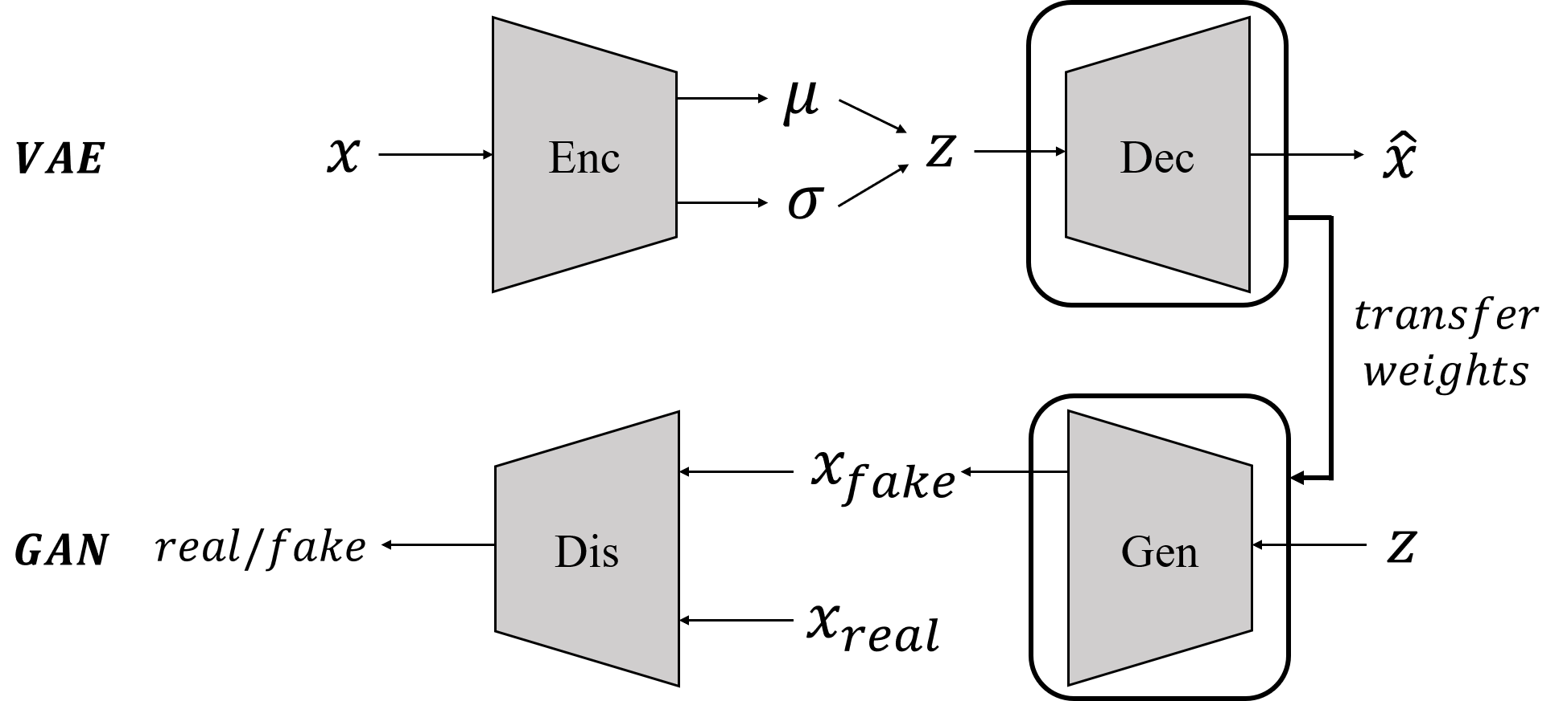
From VAE to GANs
Same job for these two models!
(i.e. generate images using a noise vector as input)

Slide 50
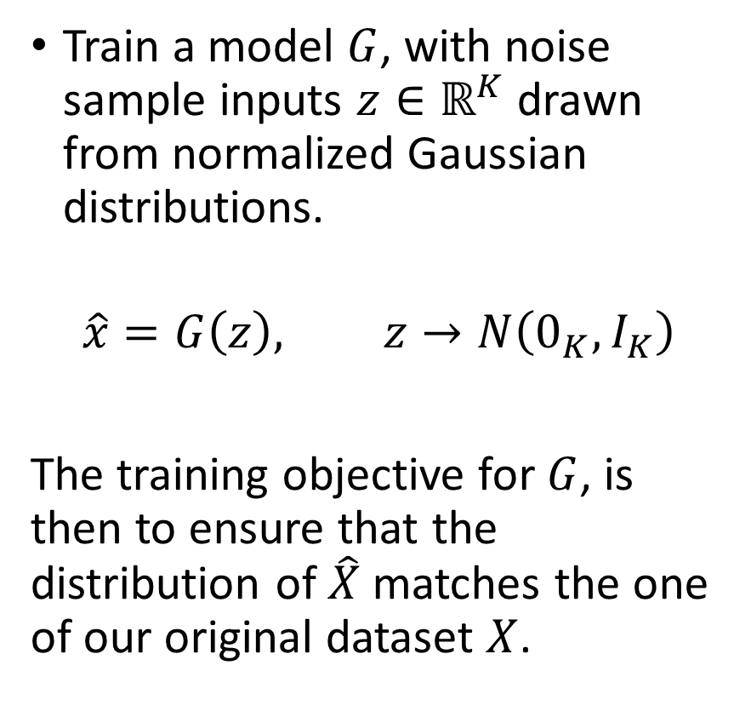
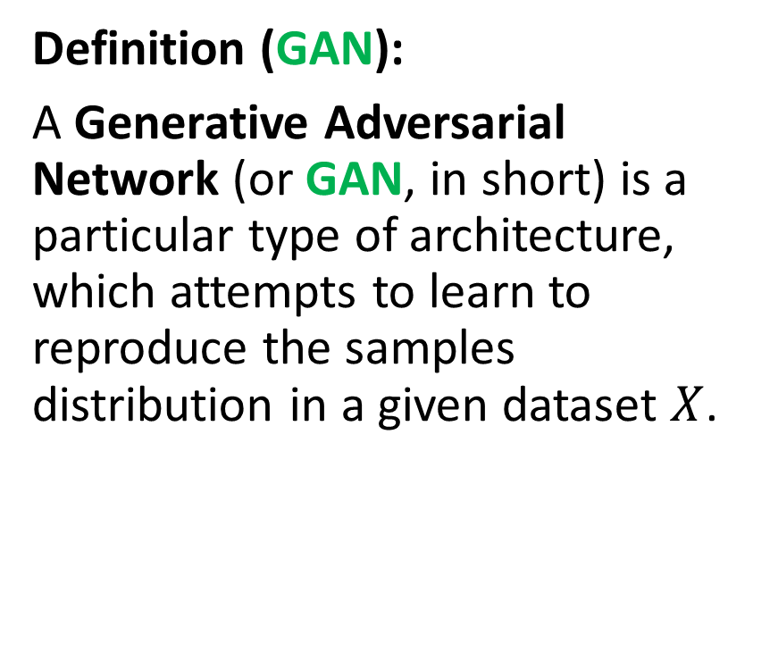
GAN definition
Definition (GAN):
A Generative Adversarial Network (or GAN, in short) is a particular type of architecture, which attempts to learn to reproduce the samples distribution in a given dataset $X$.
Train a model $G$, with noise sample inputs $z∈ℝ^{K}$ drawn from normalized Gaussian distributions.
$$\hat{x}=G\left(z\right), z→N\left(0_{K},I_{K}\right)$$
The training objective for $G$, is then to ensure that the distribution of $\hat{X}$ matches the one of our original dataset $X$.

Slide 51
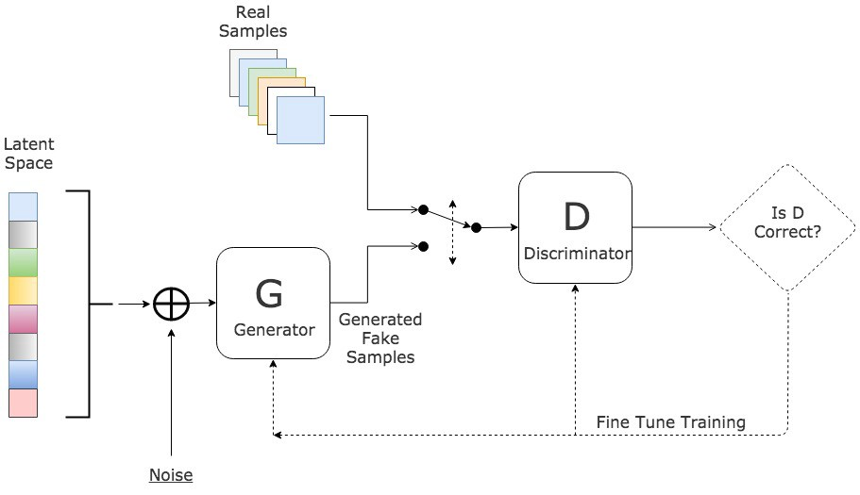
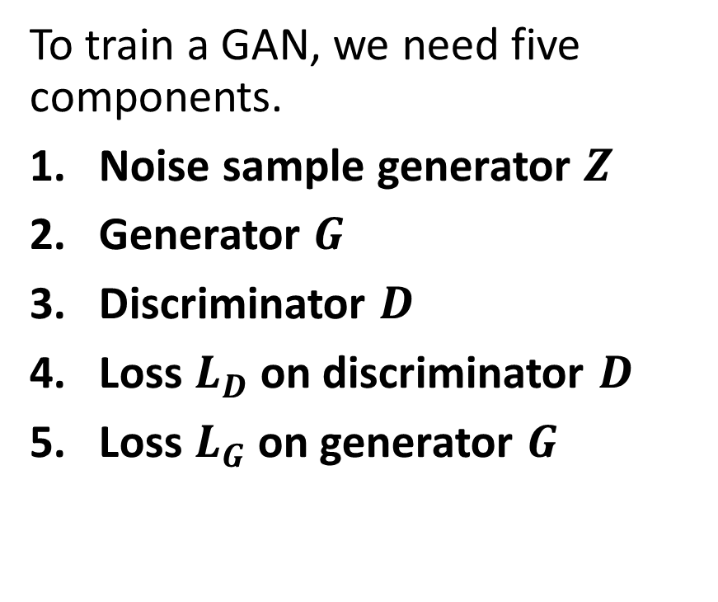
Vanilla GAN architecture
To train a GAN, we need five components.
Noise sample generator $Z$
Generator $G$
Discriminator $D$
Loss $L_{D}$on discriminator $D$
Loss $L_{G}$on generator $G$

Slide 52
Vanilla GAN architecture

Slide 53
Vanilla GAN architecture
To train a GAN, we need five components.
Noise sample generator $Z$
Generator $G$
Discriminator $D$
Loss $L_{D}$on discriminator $D$
Loss $L_{G}$on generator $G$

Slide 54
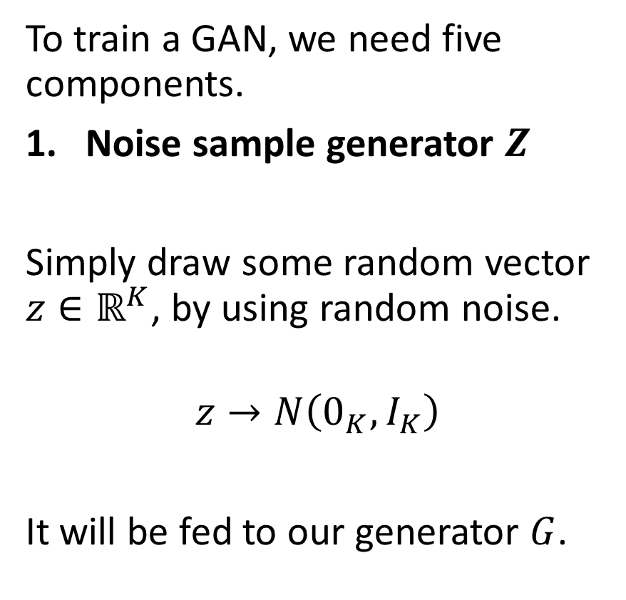
Vanilla GAN architecture
To train a GAN, we need five components.
Noise sample generator $Z$
Simply draw some random vector $z∈ℝ^{K}$, by using random noise.
$$z→N\left(0_{K},I_{K}\right)$$
It will be fed to our generator $G$.

Slide 55
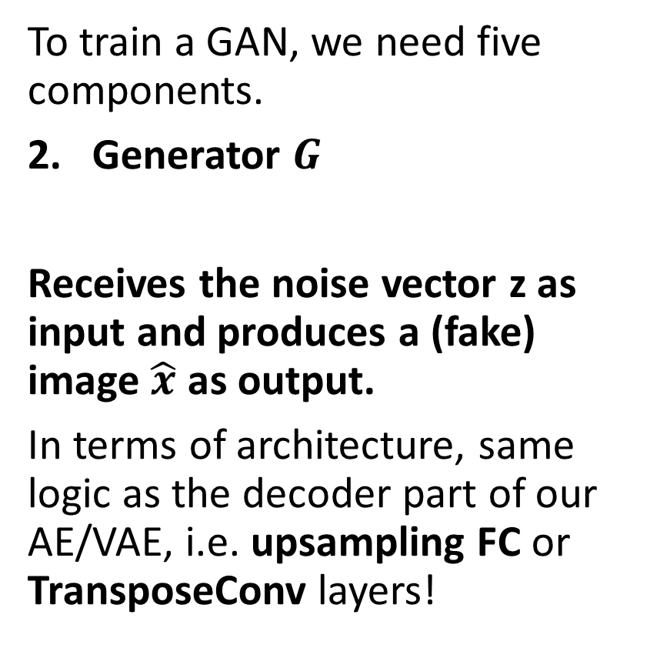
Vanilla GAN architecture
To train a GAN, we need five components.
Generator $G$
Receives the noise vector z as input and produces a (fake) image $\hat{x}$ as output.
In terms of architecture, same logic as the decoder part of our AE/VAE, i.e. upsampling FC or TransposeConv layers!

Slide 56
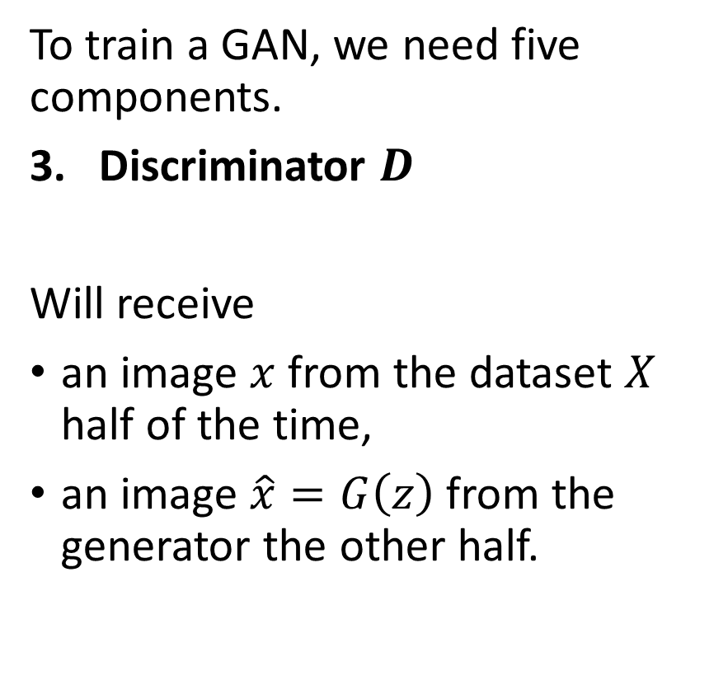
Vanilla GAN architecture
To train a GAN, we need five components.
Discriminator $D$
Will receive
an image $x$ from the dataset $X$ half of the time,
an image $\hat{x}=G\left(z\right)$ from the generator the other half.
Binary classification: needs to classify the image as fake (0) or real (1).

Slide 57
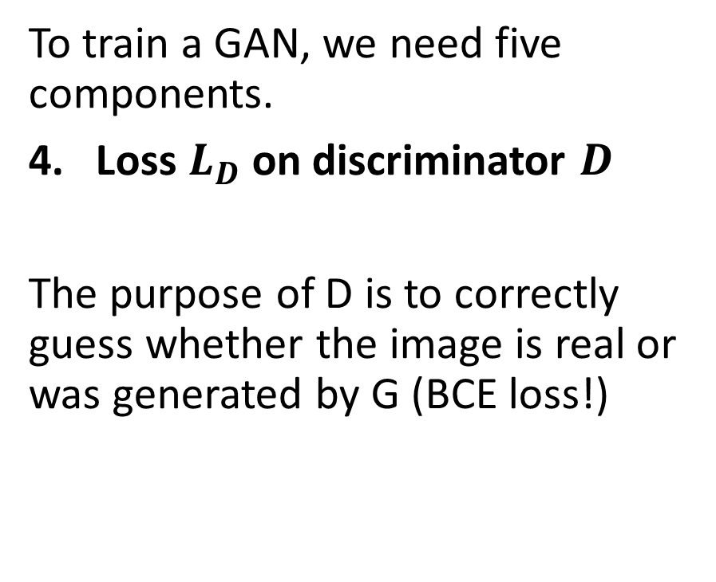
Vanilla GAN architecture
To train a GAN, we need five components.
Loss $L_{D}$on discriminator $D$
The purpose of D is to correctly guess whether the image is real or was generated by G (BCE loss!)
The first component checks if the discriminator is correctly classifying the real samples.
The second component checks if the discriminator correctly classifies the fake samples.
$$L_{D}=\frac{1}{N}\sum_{x_{i}∈minibatch(X_{N})}{−\log\left(D\left(x_{i}\right)\right)}+\frac{1}{N}\sum_{z_{i}∈minibatch(N)}{−\log\left(1−D\left(G\left(z_{i}\right)\right)\right)}$$

Slide 58
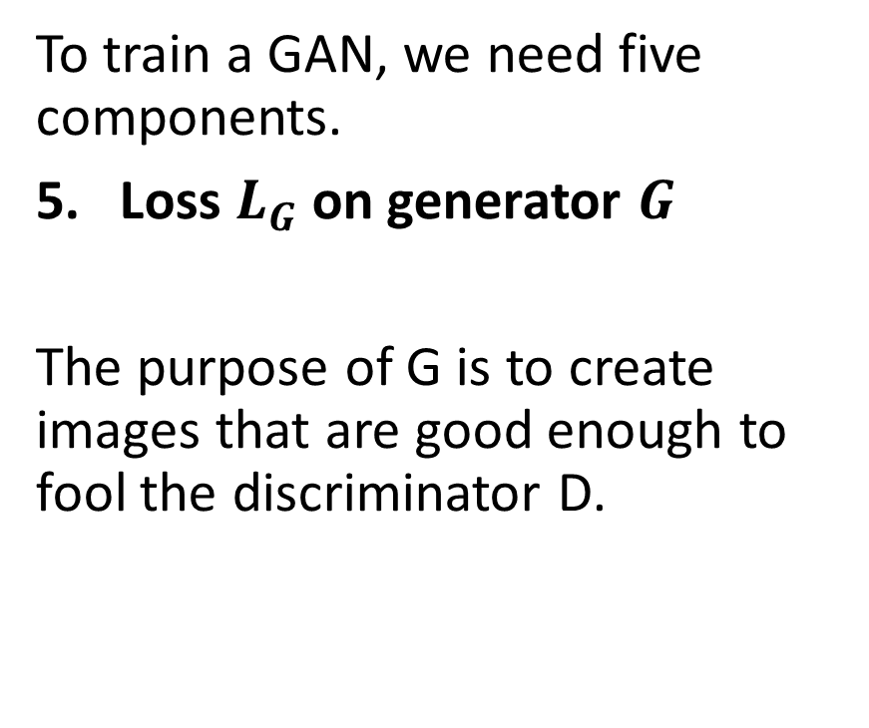
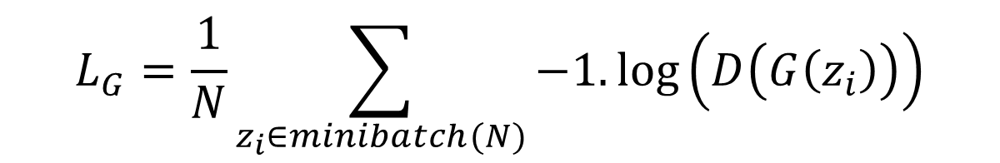
Vanilla GAN architecture
To train a GAN, we need five components.
Loss $L_{G}$on generator $G$
The purpose of G is to create images that are good enough to fool the discriminator D.
$$L_{G}=\frac{1}{N}\sum_{z_{i}∈minibatch(N)}{−1.\log\left(D\left(G\left(z_{i}\right)\right)\right)}$$

Slide 59
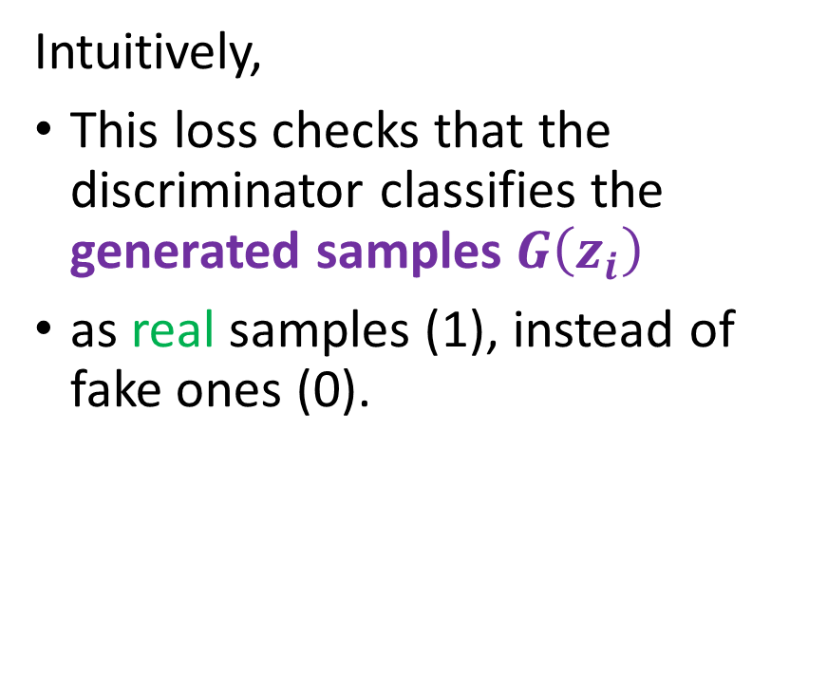
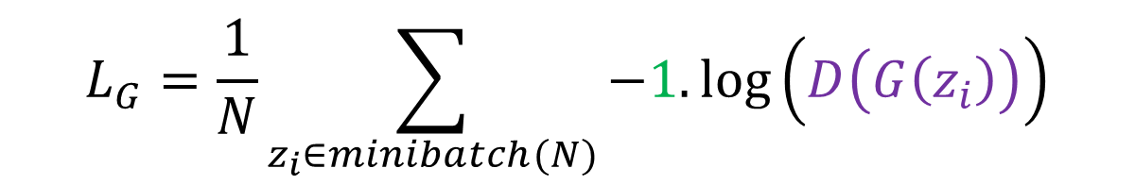
Vanilla GAN architecture
To train a GAN, we need five components.
Loss $L_{G}$on generator $G$
The purpose of G is to create images that are good enough to fool the discriminator D.
Intuitively,
This loss checks that the discriminator classifies the generated samples $G\left(z_{i}\right)$
as real samples (1), instead of fake ones (0).
$$L_{G}=\frac{1}{N}\sum_{z_{i}∈minibatch(N)}{−1.\log\left(D\left(G\left(z_{i}\right)\right)\right)}$$

Slide 60
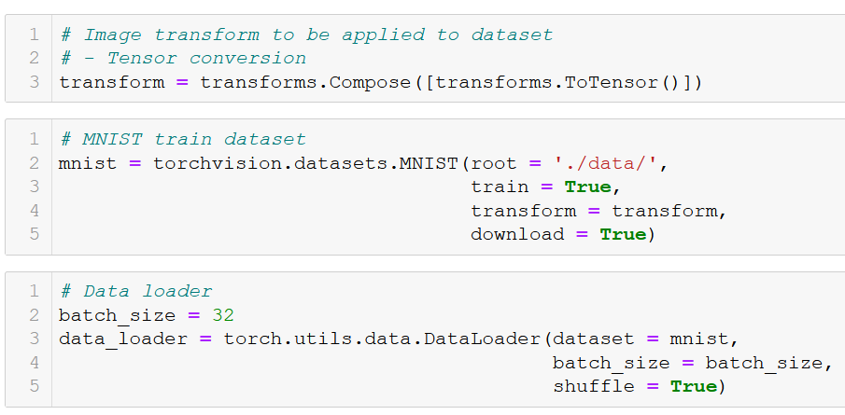
GAN implementation: dataset

Slide 61
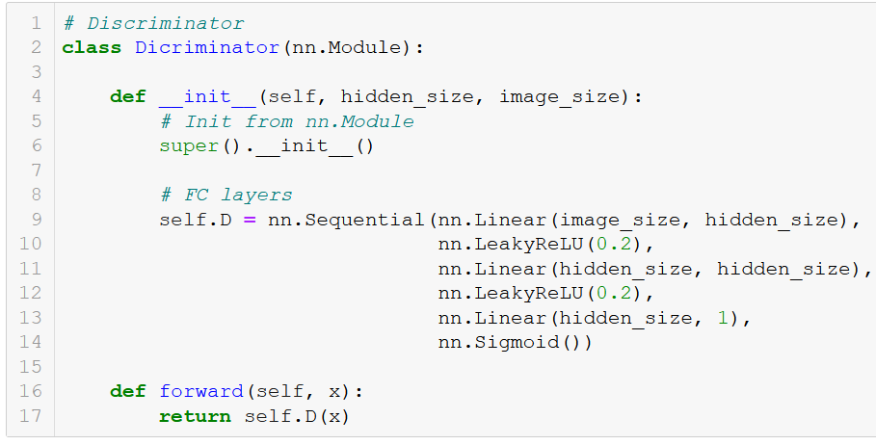
GAN implementation: discriminator
For simplicity, our discriminator, will be designed as stacked downsampling FC layers.
Freely decide on the hidden layer sizes.
(Later on, we will replace these layers with Conv2d ones, which are much better layers to use when it comes to images!)

Slide 62
GAN implementation: discriminator

Slide 63
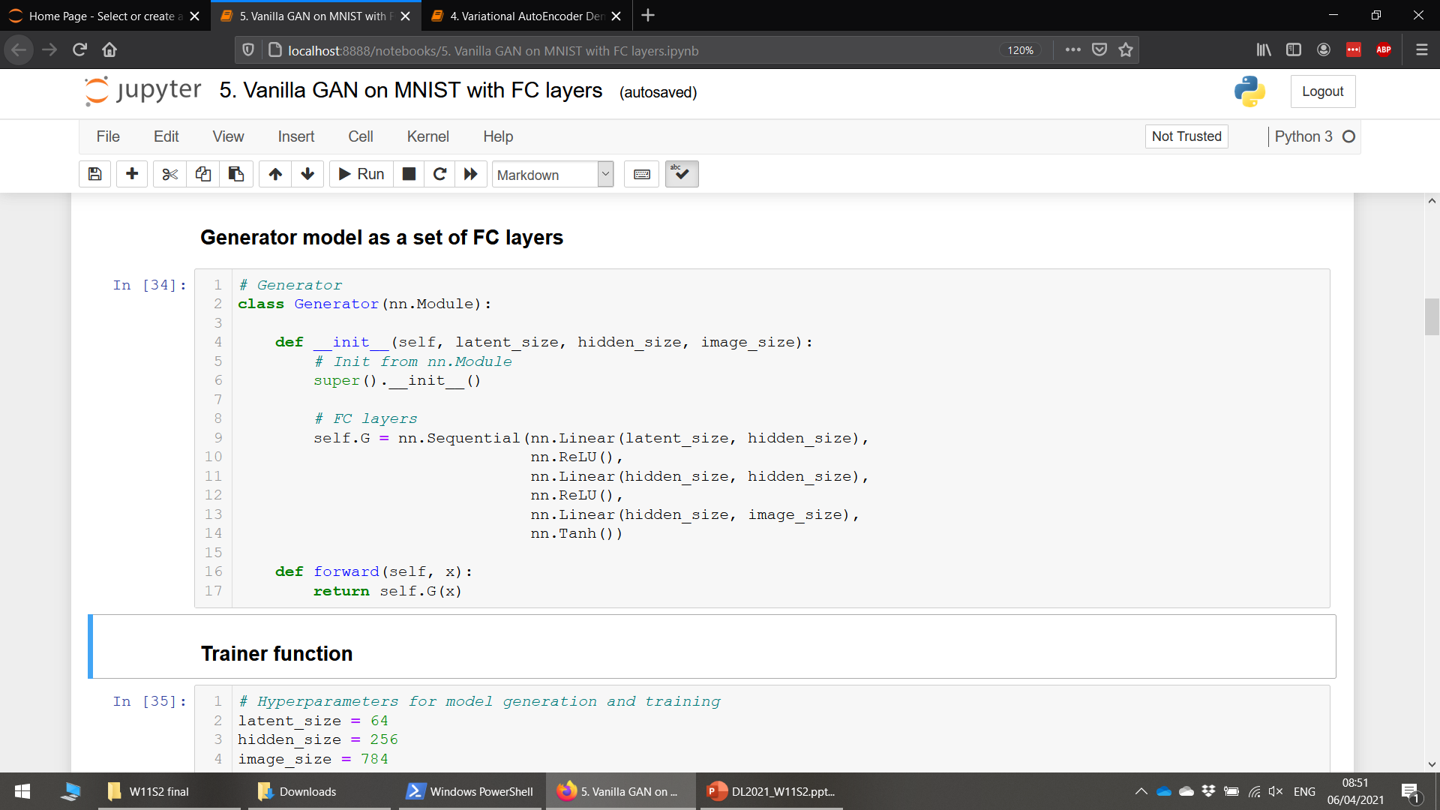
GAN implementation: generator
For simplicity, our generator will mirror the operations of our discriminator (Same intuition as with Encoder and Decoder in AutoEncoder models).
It will therefore consist of upsampling FC layers.
(Later on, we might replace these layers with Conv2d and TransposeConv2d ones, which are easier to train and much better at working with images!)

Slide 64
GAN implementation: generator

Slide 65
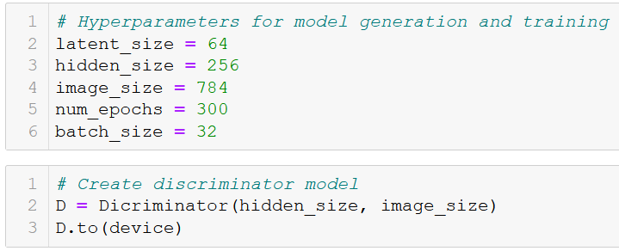


GAN implementation: trainer
Start by defining hyperparameters and models.
Latent size for noise samples fed to generator arbitrarily fixed.
Adam, with almost default parameters, arbitrarily chosen.
Losses on D and G for training curves later on.
Also, accuracy scores of D on real and fake samples for visualization after training.

Slide 66

GAN implementation: trainer
Start by processing the samples
Generate N (mini-batch size) random noise samples, which will later be fed to generator. Make their labels 0.
Draw N (mini-batch size) samples from the dataset X, which will be fed to discriminator later on. Make their labels 1.
Flatten images (FC layers!)

Slide 67
GAN implementation: trainer

Slide 68

GAN implementation: trainer
Train the discriminator
Pass real samples to $D$, check if it is able to classify these samples correctly as real (1).
Compute the first half of the loss and the accuracy of $D$ on these real samples.
Pass noise samples to generator $G$, and output images to discriminator $D$, check if it is able to classify these images correctly as fake (0).
Compute the second half of the loss and the accuracy of $D$ on these fake samples.
Backpropagate $D$ on the computed combined loss.

Slide 69

GAN implementation: trainer

Slide 70

GAN implementation: trainer
Train the generator
Produce a fresh batch of noise samples to be fed to the generator.
Produce fake images by feeding these noise samples to generator $G$.
Pass fake images to discriminator $D$, check if it is misclassifying these samples as real (1) instead of fake.
Backpropagate $G$ on the computed loss.

Slide 71

GAN implementation: trainer

Slide 72
GAN implementation: interleaved training
Definition (interleaved training):
In general, we like to train a discriminator, while the generator is fixed, and vice-versa. We then alternate a few rounds of training on the discriminator/generator, effectively training both at the “same” time.
This prevents the discriminator from getting used to what the generator is producing and in turn, forces the generator to generate better samples, with higher chance of fooling the discriminator.
This is called an interleaved training, and is very common in GANs, or even game theory where multiple players trying to figure out their best strategies, with contradicting objectives.
However, this does not ensure that the GAN training will converge!

Slide 73

GAN implementation: trainer
Update loss and accuracy history after each mini-batch.
Display on periodic epoch values for convenience.

Slide 74

GAN training visuals
After training, we can visualize the losses.
Convergence seems to be happening on the losses.
(A few more iterations would have probably been good).

Slide 75

GAN training visuals
After training, we can visualize the accuracies as well.
Convergence seems to be happening on the accuracies too.
(A few more iterations would have probably been good).

Slide 76

GAN training visuals
After training, we can visualize the accuracy scores of $D$ on both the real and fake samples.
Convergence seems to be happening on the accuracies as well.
It does not seem that $G$ was able to completely fool $D$ (50% score accuracy as optimal target?)
But do we care?

Slide 77


GAN training visuals
Seriously, do we care?
No, because what matters is that we get a generator $G$ that is trained well enough to generate plausible (!) images!
(On a side note, when is the last time we saw this “plausible” keyword BTW? How about the “adversarial” keyword? Could that mean GANs could be used as attack functions?)

Slide 78
GAN training visuals

Slide 79


GAN training visuals
Seriously, do we care?
No, because what matters is that we get a generator $G$ that is trained well enough to generate plausible (!) images!
Overall, plausible images!
Extra implementation: could we remove noise, by using Conv2d and TransposeConv2d layers instead of FC layers in the generator?

Slide 80
Conclusion
In this lecture
Main issues of traditional Autoencoders
Diversity on feature representation using stochastic latent representations
Variational Autoencoder and stochastic latent representations
Basic Generative Adversarial Networks: ideas and procedure.
In the next lectures
More advanced concepts on GANs

Slide 81
Learn more about these topics
Out of class, for those of you who are curious
Reference paper on VAEs. Kingma et al., “An Introduction to Variational Autoencoders”, 2013. https://arxiv.org/abs/1906.02691
Reference paper on vanilla GANs. Goodfellow et al., “Generative Adversarial Networks”, 2014. https://arxiv.org/abs/1406.2661
Make music with VAEs! https://www.youtube.com/watch?v=G5JT16flZwM&list=PLBUMAYA6kvGU8Cgqh709o5SUvo-zHGTxr

Slide 82


A mathematical motivation (out-of-class)
Suppose that there exists some hidden variable $z$ which generates an observation $x$.
Suppose that we would like to infer the characteristics of $z$, but we only see $x$.
In other words, we’d like to compute $p(z|x).$
That is what our encoder does with x = original image and z = bottleneck vector.
Using Bayes Theorem, we have
$$p\left(z | x\right)=\frac{p\left(x | z\right) p(z)}{p(x)}$$
Unfortunately, computing $p(x)$is difficult
$$p\left(x\right)=\int{p\left(x | z\right) p\left(z\right) dz}$$

Slide 83


A mathematical motivation (out-of-class)
Suppose that there exists some hidden variable $z$ which generates an observation $x$.
Suppose that we would like to infer the characteristics of $z$, but we only see $x$.
In other words, we’d like to compute $p(z|x).$
That is what our encoder does with x = original image and z = bottleneck vector.
Using Bayes Theorem, we have
$$p\left(z | x\right)=\frac{p\left(x | z\right) p(z)}{p(x)}$$
Unfortunately, computing $p(x)$is difficult
$$p\left(x\right)=\int{p\left(x | z\right) p\left(z\right) dz}$$
This part is a Gaussian distribution (easy)

Slide 84

A mathematical motivation (out-of-class)
Suppose that there exists some hidden variable $z$ which generates an observation $x$.
Suppose that we would like to infer the characteristics of $z$, but we only see $x$.
In other words, we’d like to compute $p(z|x).$
That is what our encoder does with x = original image and z = bottleneck vector.
Using Bayes Theorem, we have
$$p\left(z | x\right)=\frac{p\left(x | z\right) p(z)}{p(x)}$$
Unfortunately, computing $p(x)$is difficult
$$p\left(x\right)=\int{p\left(x | z\right) p\left(z\right) dz}$$
This part is a our decoder effect (easy)

Slide 85

A mathematical motivation (out-of-class)
Suppose that there exists some hidden variable $z$ which generates an observation $x$.
Suppose that we would like to infer the characteristics of $z$, but we only see $x$.
In other words, we’d like to compute $p(z|x).$
That is what our encoder does with x = original image and z = bottleneck vector.
Using Bayes Theorem, we have
$$p\left(z | x\right)=\frac{p\left(x | z\right) p(z)}{p(x)}$$
Unfortunately, computing $p(x)$is difficult
$$p\left(x\right)=\int{p\left(x | z\right) p\left(z\right) dz}$$
Summing it over all the possible z representations? Hard to compute (requires understanding of encoder).

Slide 86

A mathematical motivation (out-of-class)
Suppose that there exists some hidden variable $z$ which generates an observation $x$.
Suppose that we would like to infer the characteristics of $z$, but we only see $x$.
In other words, we’d like to compute $p(z|x).$
That is what our encoder does with x = original image and z = bottleneck vector.
Using Bayes Theorem, we have
$$p\left(z | x\right)=\frac{p\left(x | z\right) p(z)}{p(x)}$$
Unfortunately, computing $p(x)$is difficult
$$p\left(x\right)=\int{p\left(x | z\right) p\left(z\right) dz}$$
Oh, no, this is mathematically untractable!

Slide 87

A mathematical motivation (out-of-class)
Workaround: approximate $p(z|x)$by another distribution $q(z|x)$which will be defined such that it has a tractable distribution.
If we can define the parameters of $q(z|x)$such that it is very similar to $p\left(z | x\right)$, we can use it to perform approximate inference of the intractable distribution.
We later simply compute $p\left(z | x\right)$, by using $q(z|x)$instead.
The only thing we need, then, is a way to measure if $q(z|x)$ is a good approximate measure of $p\left(z | x\right)$.
In general, we will even choose a distribution $q$, independently of $x$, that is $q\left(z | x\right)=q(z)$.

Slide 88


On the minimization of the KL Divergence (out-of-class)
Finding a good distribution q that matches p, then requires to minimize the KL divergence.
$$\min{\sum_{x}{p\left(x\right)\log\left(\frac{p\left(x\right)}{q\left(x\right)}\right)}}$$
Applied to our problem
$$\min{\sum_{z}{−q(z)\log\left(\frac{q(z)}{p(z|x)}\right)}}$$
This is equivalent to
$$\max{\sum_{z}{−q(z)\log\left(\frac{q(z)}{p(z|x)}\right)}}$$

Slide 89


On the minimization of the KL Divergence (out-of-class)
Finding a good distribution q that matches p, then requires to minimize the KL divergence.
$$\min{\sum_{x}{p\left(x\right)\log\left(\frac{p\left(x\right)}{q\left(x\right)}\right)}}$$
Applied to our problem
$$\min{\sum_{x}{−q(z)\log\left(\frac{q(z)}{p(z|x)}\right)}}$$
This is equivalent to
$$\max{\sum_{z}{q(z)\log\left(\frac{q(z)}{p(z|x)}\right)}}$$
Which is equivalent to
$$\max{\sum_{z}{−q(z)\log\left(\frac{p(z|x)}{q(z)}\right)}}$$

Slide 90

On the minimization of the KL Divergence (out-of-class)
Using Bayes’ formula
$$\max{\sum_{z}{−q(z)\log\left(\frac{p\left(x,z\right)}{q(z)}\right)+\sum_{z}{q\left(z\right)\log\left(p(x)\right)}}}$$
$$\max{\sum_{z}{−q(z)\log\left(\frac{p\left(x,z\right)}{q(z)}\right)+\log\left(p(x)\right)\sum_{z}{q\left(z\right)}}}$$
By definition, we have $\sum_{z}{q\left(z\right)=1}$, and
$$\max{\sum_{z}{−q(z)\log\left(\frac{p\left(x,z\right)}{q(z)}\right)+\log\left(p(x)\right)}}$$

Slide 91

On the minimization of the KL Divergence (out-of-class)
But $\log\left(p(x)\right)$ is a constant quantity here. It is then equivalent to
$$\max{\sum_{z}{−q(z)\log\left(\frac{p\left(x,z\right)}{q(z)}\right)}}$$

Slide 92

On the minimization of the KL Divergence (out-of-class)
But $\log\left(p(x)\right)$ is a constant quantity here. It is then equivalent to
$$\max{\sum_{z}{−q(z)\log\left(\frac{p\left(x,z\right)}{q(z)}\right)}}$$
Splitting it with Bayes’ formula again gives
$$\max{\sum_{z}{−q(z)\log\left(p\left(z | x\right)\right)}}+\sum_{z}{q(z)\log\left(\frac{p\left(x\right)}{q(z)}\right)}$$
$$\max{[ −E_{q\left(z\right)}\left[log⁡(p\left(z | x\right))\right]}+D_{KL}\left(q | \left|p\right) \right]$$
$$min [{E_{q\left(z\right)}\left[log⁡(p\left(z | x\right))\right]}−D_{KL}\left(q | \left|p\right) \right]$$

Slide 93

On the minimization of the KL Divergence (out-of-class)
Final twist: $q\left(z\right)$ and $q\left(z|x\right)$ are identical (can you see why?)
$$min [{E_{q\left(z|x\right)}\left[log⁡(p\left(z | x\right))\right]}−D_{KL}\left(q | \left|p\right) \right]$$
The first term represents the reconstruction log-likelihood, or in other word, a good reconstruction of the images!
And the second term ensures that our learned distribution q is similar to the true prior distribution p!
(Need to take it slow? Full proof of previous calculation here https://www.youtube.com/watch?v=uaaqyVS9-rM&t=1182s)

